Slide 1
Vorlesung Kontextsensitive Systeme
Smart Data/Big Data

Slide 2
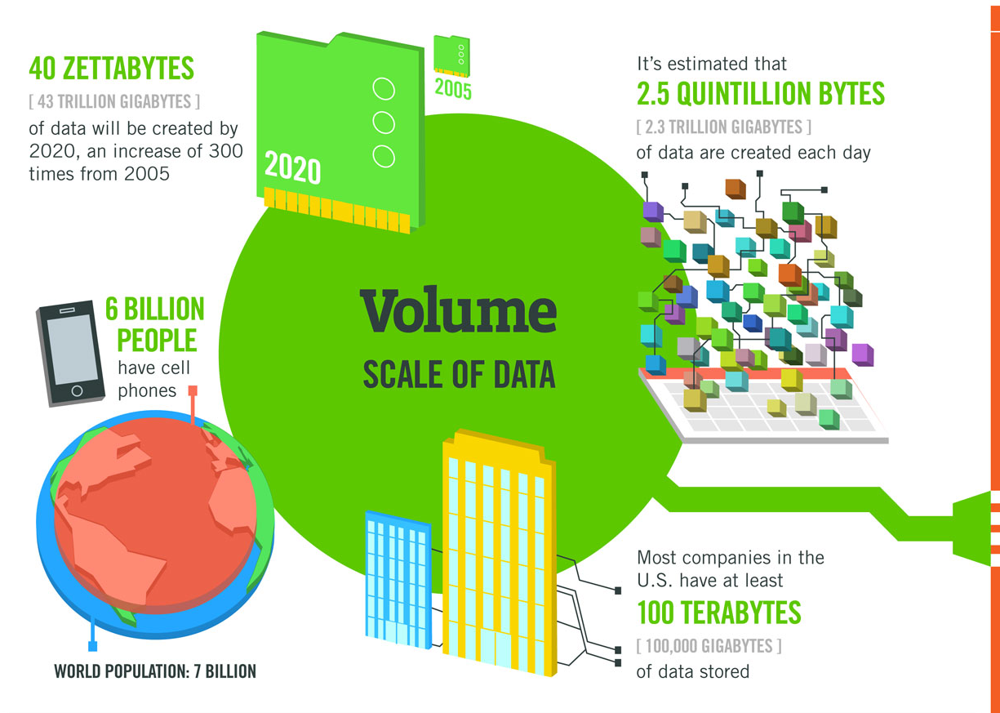

Slide 3
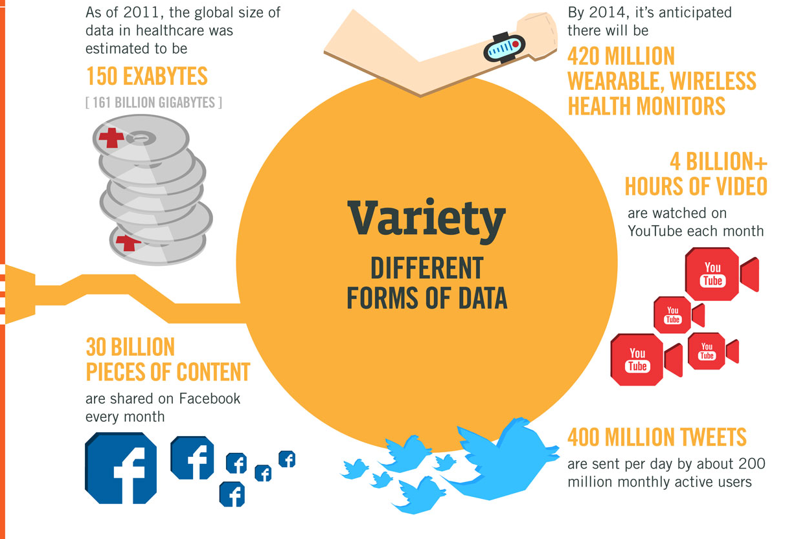

Slide 4
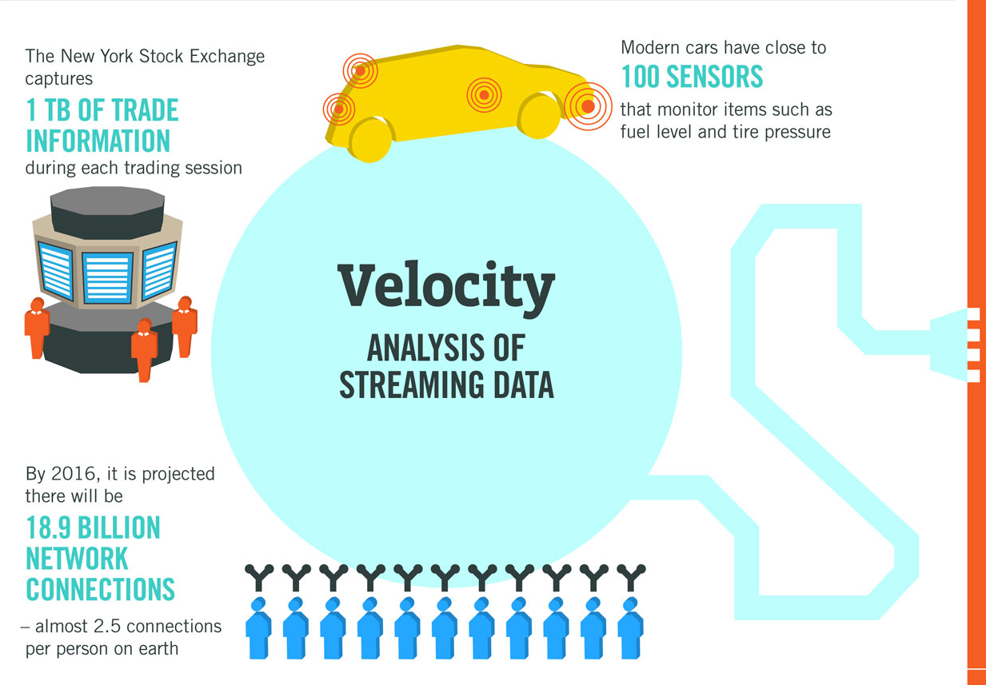

Slide 5
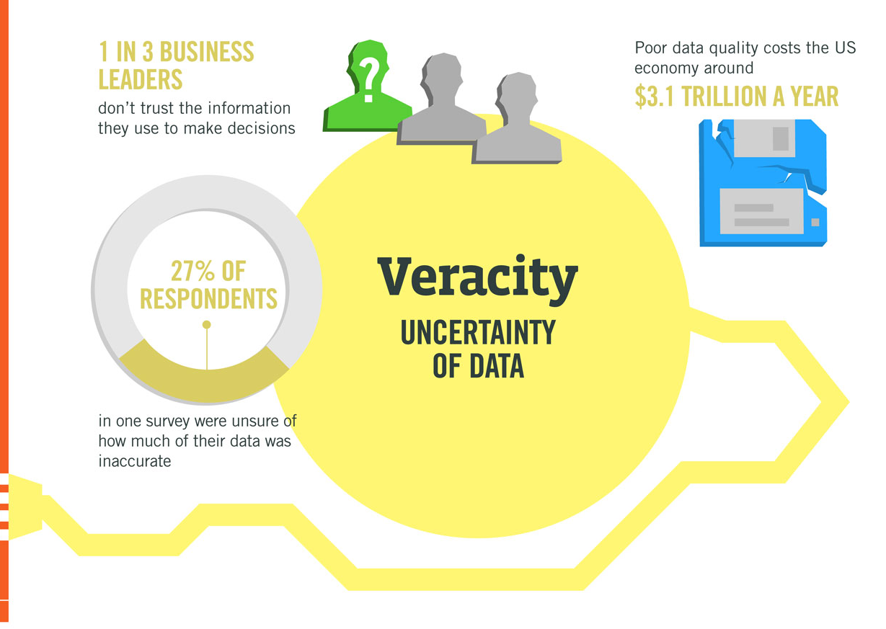

Slide 6
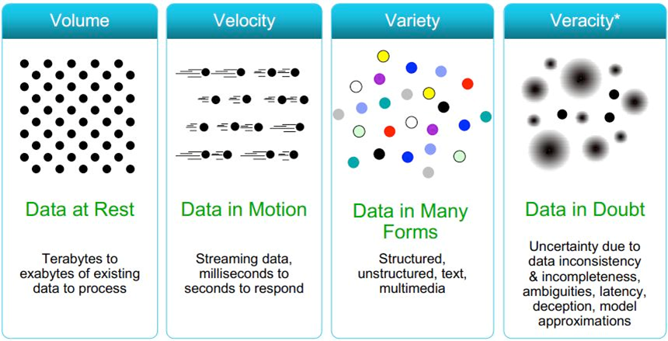
What makes data big

Slide 7
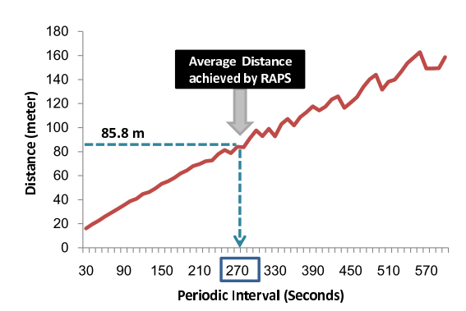
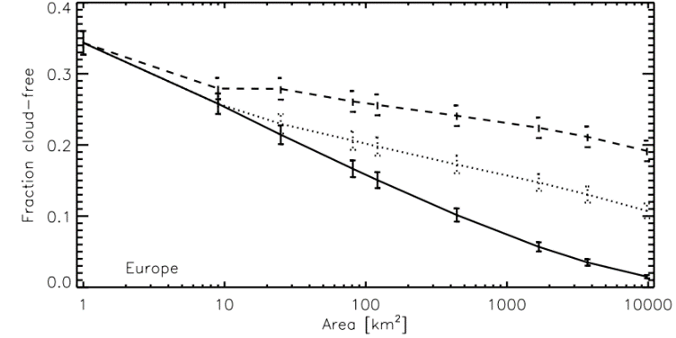

Why Big Data Matters: Dimension of Convergence
Location Uncertainty vs. GPS Sampling Rate
Paek, J., Kim, J., Govindan, R.: Energy-efﬁcient rate-adaptive GPS-based positioning for smartphones. In: Proc. of the 8th Intl. Conf. on Mobile systems applications and services MobiSys 10, MobiSys ’10, p. 299ff. ACM, ACM Press (2010)
Time
Frequency
Delay
Location
Information
Perception
# Phenomena
Resolution
Error
Reality
Krijger, J. M., van Weele, M., Aben, I., and Frey, R.: Technical Note: The effect of sensor resolution on the number of cloud-free observations from space, Atmos. Chem. Phys., 7, 2881-2891

Slide 8



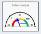




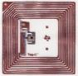







Internet of Things and Services
People
Meaningful
Presentation
roles
embedded analytics
collaboration
roles
Information
/Services
alerts
A2A
B2B
Internet of Things
Leg- acy
SCM
ERP
PLM
EHM
SRM
CRM
PLM
Middleware
Smart Items
Reality
/Things

Slide 9
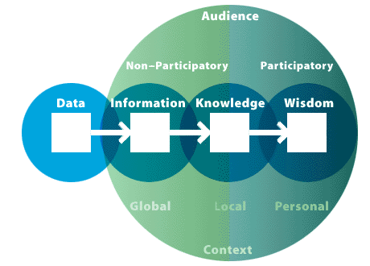
Smart Data: From Data to Wisdom
Information makes data meaningful for audiences because it requires the creation of relationships and patterns between data.
Transforming data into information is accomplished by organizing it into a meaningful form, presenting it in meaningful and appropriate ways, and communicating the context around it.
Source: Nathan Shedroff, nathan.com

Slide 10
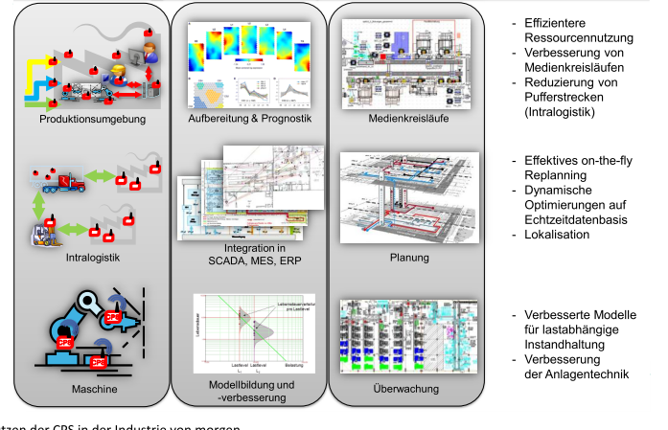
Context Sensitive Systems w/ Predictive Analytics Planning, Control, Real Time Reaction
Massive Ad-hoc Deployment of CPS-Systems, Recognition of Process related parameters
Automatic Correlation to find novel insights
Use of the data for planning, controlling processes

Slide 11











Typical Big Data Architecture
VISUALIZE
INGEST
PROCESS
STORE
ANALYZE

Slide 12
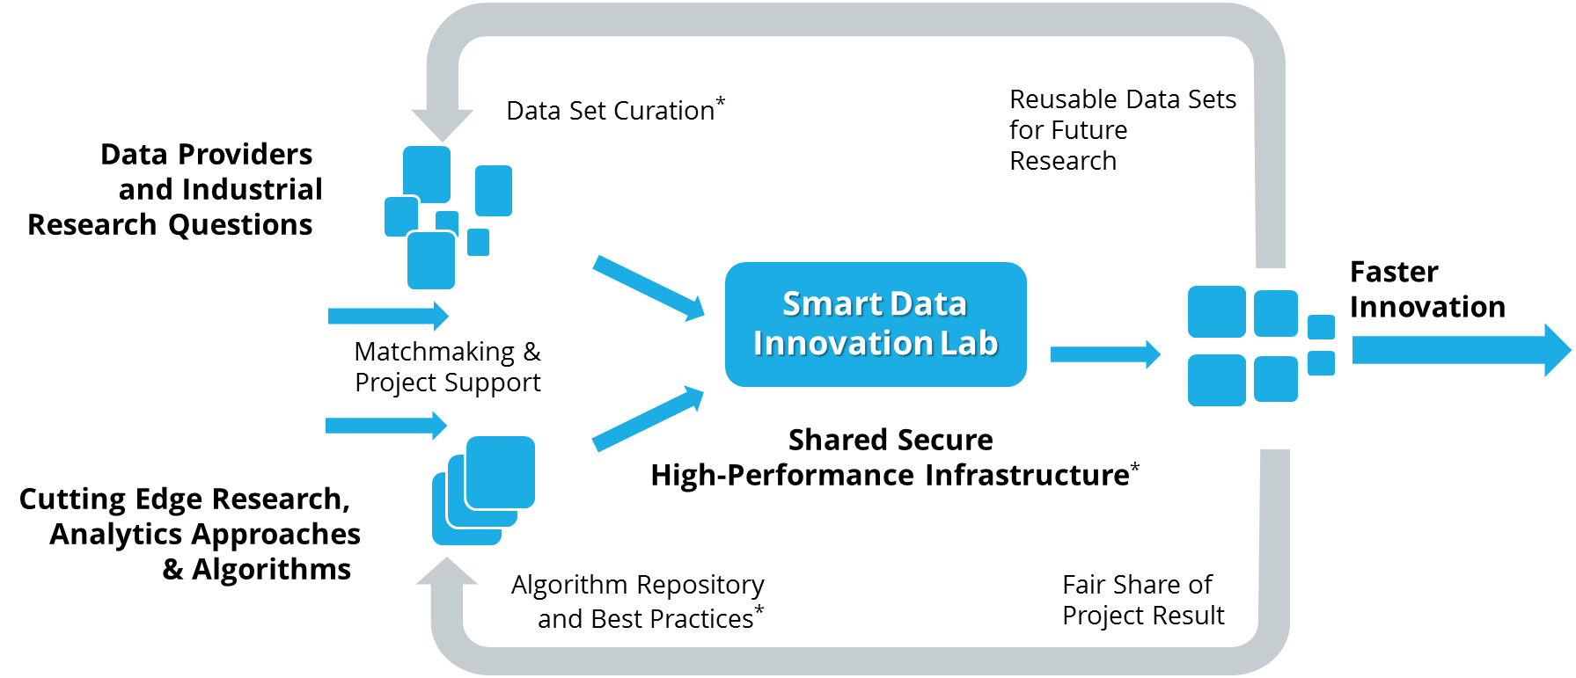
Innovation durch Daten?
Data
Components
Context Sensitive Systems
Machine Learning as key component!

Slide 13
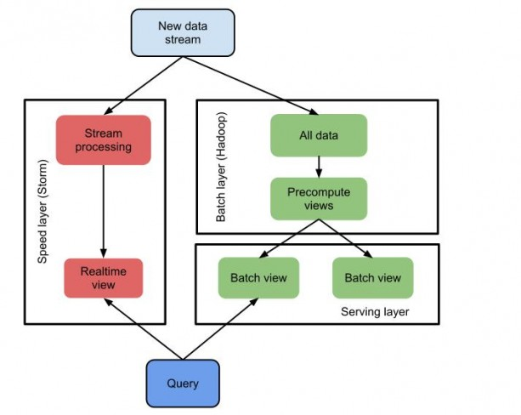
Lambda Architecture
Serving Layer (e.g. HANA)

Slide 14
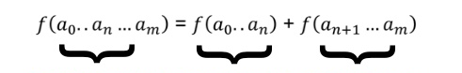
query = function (all data)
query
batch
realtime
Lambda Architecture splits realtime and batch tasks
e.g CSS = Offline Learning + Realtime Classification
Batch Layer Hadoop
Realtime Processing

Slide 15
What is Hadoop?
Software platform that lets one easily write and run applications that process vast amounts of data. It includes:
MapReduce – offline computing engine
HDFS – Hadoop distributed file system
HBase – online data access
Here's what makes it especially useful:
Scalable: It can reliably store and process petabytes
Economical: It distributes the data and processing across clusters of commonly available computers (in thousands)
Efficient: By distributing the data, it can process it in parallel on the nodes where the data is located
Reliable: It automatically maintains multiple copies of data and automatically redeploys computing tasks based on failures

Slide 16
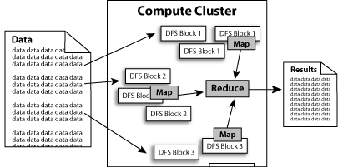
What does it do?
Hadoop implements Google’s MapReduce, using HDFS
MapReduce divides applications into many small blocks of work
HDFS creates multiple replicas of data blocks for reliability, placing them on compute nodes around the cluster
MapReduce can then process the data where it is located
Hadoop ‘s target is to run on clusters of the order of 10,000-nodes

Slide 17
Hadoop: Assumptions
It is written with large clusters of computers in mind:
Processing will be run in batches. Thus there is an emphasis on high throughput as opposed to low latency
Applications that run on HDFS have large data sets. A typical file in HDFS is gigabytes to terabytes in size
Applications need a write-once-read-many access model
Moving Computation is Cheaper than Moving Data

Slide 18
HDFS
The Hadoop Distributed File System (HDFS) is a distributed file system designed to run on commodity hardware. It has many similarities with existing distributed file systems. However, the differences from other distributed file systems are significant
highly fault-tolerant and is designed to be deployed on low-cost hardware
provides high throughput access to application data and is suitable for applications that have large data sets
relaxes a few POSIX requirements to enable streaming access to file system data
part of the Apache Hadoop Core project. The project URL is http://hadoop.apache.org/core/

Slide 19

HDFS Architecture

Slide 20
Client reading files from HDFS

Slide 21
MapReduce Paradigm
Programming model developed at Google
Sort/merge based distributed computing
Initially, it was intended for their internal search/indexing application, but now used extensively by more organizations (e.g., Yahoo, Amazon.com, IBM, etc.)
It is functional style programming (e.g., LISP) that is naturally parallelizable across a large cluster of workstations or PCS.
The underlying system takes care of the partitioning of the input data, scheduling the program’s execution across several machines, handling machine failures, and managing required inter-machine communication. (This is the key for Hadoop’s success)

Slide 22
Map Reduce
Is derived from Google MapReduce.
Is a programming model for processing large datasets distributed on a large cluster.
Map phase: Once divided, datasets are assigned to the task tracker to perform the Map phase. The data functional operation will be performed over the data, emitting the mapped key and value pairs as the output of the Map phase, (i.e data processing,sorting).
Reduce phase: The master node then collects the answers to all the subproblems and combines them in some way to form the output; the answer to the problem it was originally trying to solve, (i.e data collection and digesting, merging).

Slide 23
How does MapReduce work?
The run time partitions the input and provides it to different Map instances;
Map (key, value) → (key’, value’)
The run time collects the (key’, value’) pairs and distributes them to several Reduce functions so that each Reduce function gets the pairs with the same key’
Each Reduce produces a single (or zero) file output
Map and Reduce are user written functions

Slide 24
The five common steps of parallel computing
Preparing the Map() input: This will take the input data row wise and emit key value pairs per rows, or we can explicitly change as per the requirement.
Map input: list (k1, v1).
Run the user-provided Map() code.
Map output: list (k2, v2).
Shuffle the Map output to the Reduce processors. Also, shuffle the similar keys (grouping them) and input them to the same reducer.
Run the user-provided Reduce() code: This phase will run the custom reducer code designed by developer to run on shuffled data and emit key and value.
Reduce input: (k2, list(v2)).
Reduce output: (k3, v3).
Produce the final output: Finally, the master node collects all reducer output and combines and writes them in a text file.

Slide 25
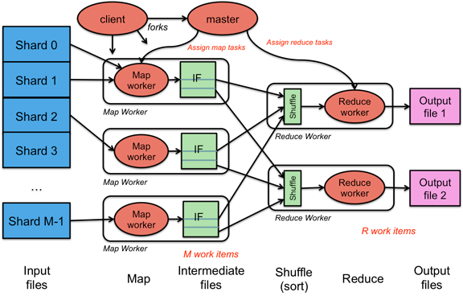
Putting the bits together

Slide 26
Example: database join

Slide 27
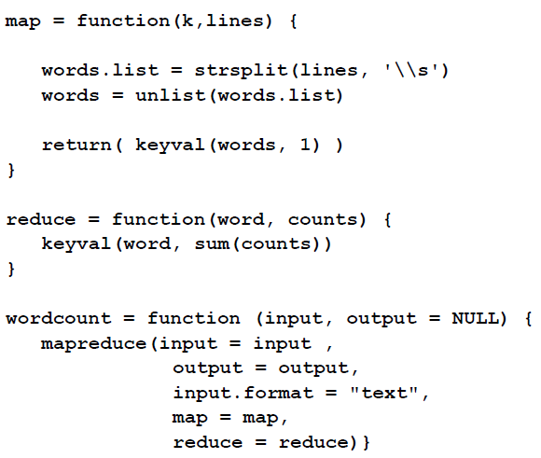
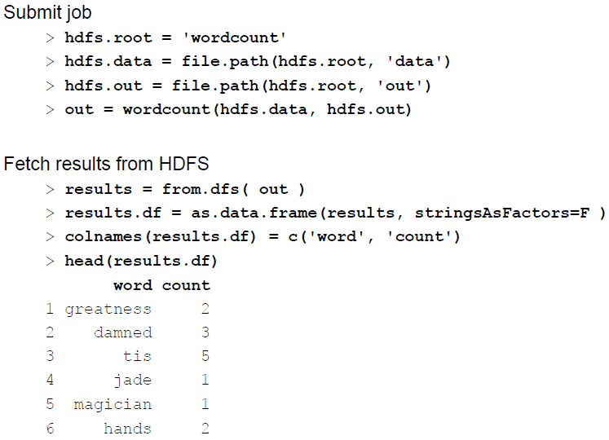
Example2: RHadoop Word Count
Map Reduce
Job Erstellen
Library(rmr2)

Slide 28
How to link R and Hadoop?
RHadoop is a great for trying out data analytics with the Hadoop platform via R functions.
These three different R packages have been designed on Hadoop’s two main features HDFS and MapReduce:
rhdfs: This is an R package for providing all Hadoop HDFS access to R. All distributed files can be managed with R functions.
rmr: This is an R package for providing Hadoop MapReduce interfaces to R. With the help of this package, the Mapper and Reducer can easily be developed.
rhbase: This is an R package for handling data at HBase distributed database through R.

Slide 29
Challenges in Classification
Many learning models work on single in memory model
R/W dependencies hinder efficient parallelization
Only problem in learning phase
Feature calculation and classification no problem
Approximate algorithms
Classification is often done on high dimensional data
Hadoop typically works by sorting in one dimension
Transformations are needed
Hadoop is typically build for batch processing
Need “realtime” answer in classification phase for CSS
Use Hadoop mostly for learning and “score” Models on different platform → speed layer
Alternative: Hadoop streaming tricks: Drastically reduce chunk size/ use custom schedulers

Slide 30
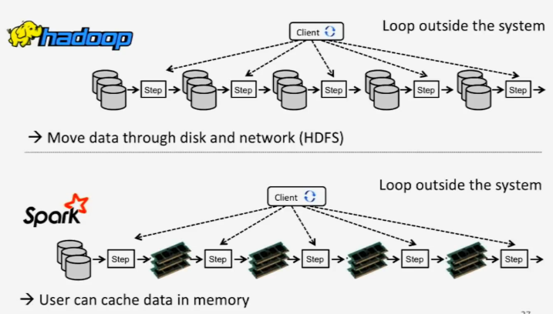
Spark: Less dependency on storage
Spark can additionally work on shared memory!

Slide 31
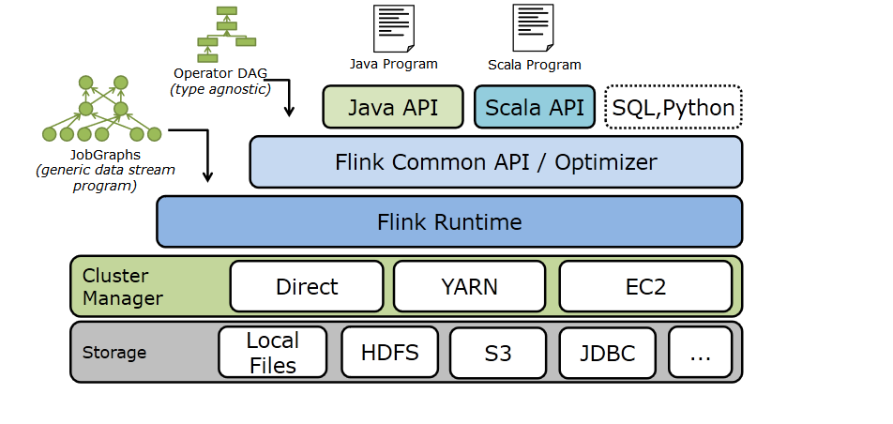
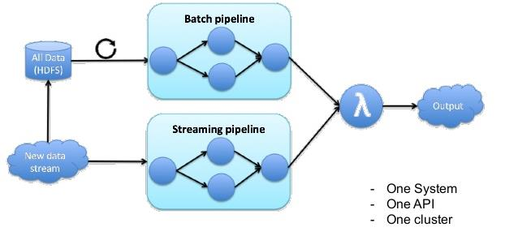
Flink: Streaming and Lambda Architecture
Realtime: normally microbatching necessary
Flink natively supports different workloads: stream, graph,…

Slide 32
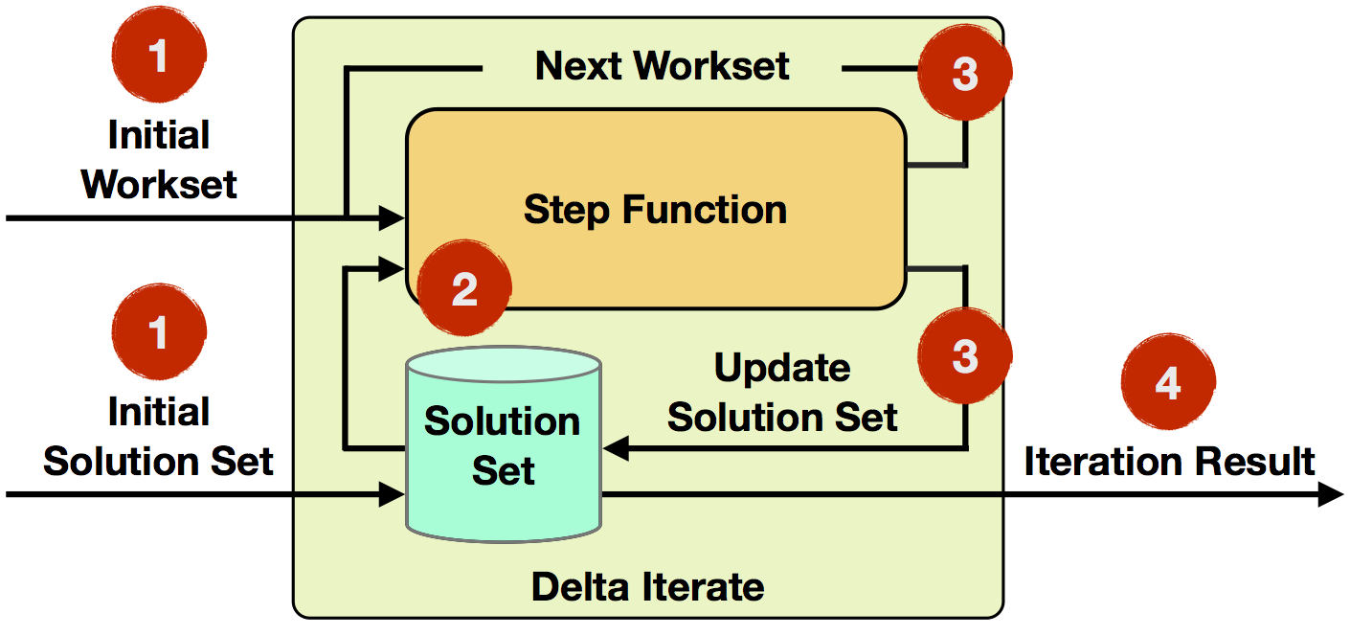
Flink: Native support for Interations

Slide 33



Classification available
Apache Mahout on MapReduce
Naïve Bayes (now deprecated)
Spark MLlib
Linear Support Vector Machines
Logistic, Linear , Isotonic Regressions
Decision Tree, Random Forests
Flink Machine Learning
SVM using Communication efficient distributed dual coordinate ascent (CoCoA)
Multiple linear regression

Slide 34
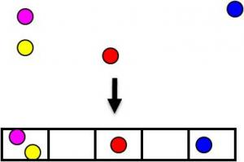
Example: KNN on Map Reduce 1/2
KNN interesting for Big Data
If amount of data approaches infinity, guaranteed to yield an error rate < 2x Bayes error rate (lowest possible)
Naïve version computationally intensive for large training sets
Linear scan or tree structures for exact solutions
Need scalable nearest neighbor search algorithms
Dimensionality reduction helps (e.g. PCA)
Locality Sensitive Hashing
→P₁=P( )
→P₂=P( )
P₁>P₂

Slide 35
Ge Song, Justine Rochas, Fabrice Huet, Frederic Magoules. Solutions for Processing K Nearest Neighbor Joins for Massive Data on MapReduce. 23rd Euromicro International Conference on Parallel, Distributed and Network-based Processing, Mar 2015, Turku, France. 2015.
Example: KNN on Map Reduce 2/2
Map function calculates LSH
Reduce function sorts and emits K-Nearest
Tradeoff: accuracy vs. speed

Slide 36
Parallelized Boosting with Map-Reduce
Computing power allows improving models
relevance, monetization, spam, etc eg. @ google
ML typically generates 10+% improvements
1% improvement is a big deal, e.g.:
Improves relevance for millions of users = Millions of dollars of revenue
GoogleSybill: https://users.soe.ucsc.edu/~niejiazhong/slides/chandra.pdf
Indranil Palit and Chandan K. Reddy, "Scalable and Parallel Boosting with MapReduce", IEEE Transactions on Knowledge and Data Engineering (TKDE), Vol.24, No.10, pp.1904-1916, October 2012. [pdf]

